Slide 1

7th Grade Math
Unit 12, Lesson 6 Problem-Solving with Volume of Cylinders Volume 2, pg. 223

Slide 2


Benchmark
MA.7.GR.2.3
Solve mathematical and real-world problems involving volume of right circular cylinders.
volume 2, pg. 223

Slide 3
Integrated Mathematical Thinking and Reasoning Standards
MA.K12.MTR.1.1 Actively participate in effortful learning both individually and collectively.
MA.K12.MTR.3.1 Complete tasks with mathematical fluency.
MA.K12.MTR.4.1 Engage in discussions that reflect on the mathematical thinking of self and others.
MA.K12.MTR.5.1 Use patterns and structure to help understand and connect mathematical concepts.
MA.K12.MTR.6.1 Assess the reasonableness of solutions.
MA.K12.MTR.7.1 Apply mathematics to real-world contexts.
volume 2, pg. 223

Slide 4

Learning Target
I can solve real-world problems involving the volume of right circular cylinders.
volume 2, pg. 223

Slide 5

Warm-Up
volume 2, pg. 224

Slide 6
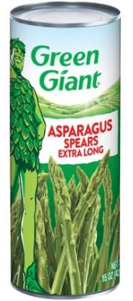
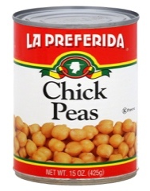


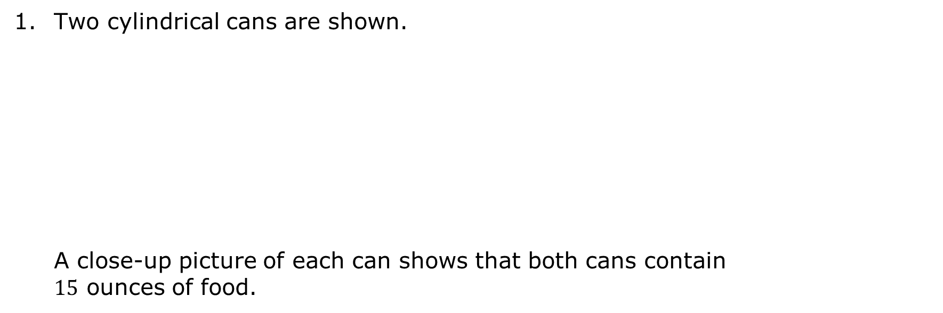
12.6.1 Warm-Up: Notice or Wonder
Two cylindrical cans are shown.
A close-up picture of each can shows that both cans contain $15$ ounces of food.
volume 2, pg. 224

Slide 7
Explain how it could be possible for two differently shaped cans to have the same volume.
Describe how the dimensions of the two cans compare to each other.
Dimension | How do they compare?
radius
height
volume 2, pg. 224

Slide 8

Exploration
volume 2, pg. 225

Slide 9

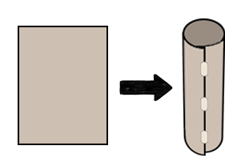
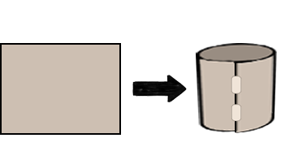
12.6.2 Exploration: Popcorn Containers
Dan is using paper to create a popcorn container. He can make two differently shaped cylindrical containers by rolling two identical pieces of paper. Container A is taller and narrower, while Container B is shorter and wider.
Container A | Container B
volume 2, pg. 225

Slide 10
Which container do you think will hold more popcorn?
Without having popcorn to test, what information would be helpful in determining which container holds more popcorn?
volume 2, pg. 225

Slide 11
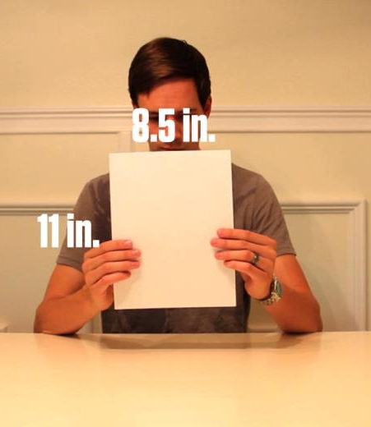

The dimensions of each piece of paper prior to rolling it to
form a cylinder are shown.
Container A | Container B
volume 2, pg. 225

Slide 12
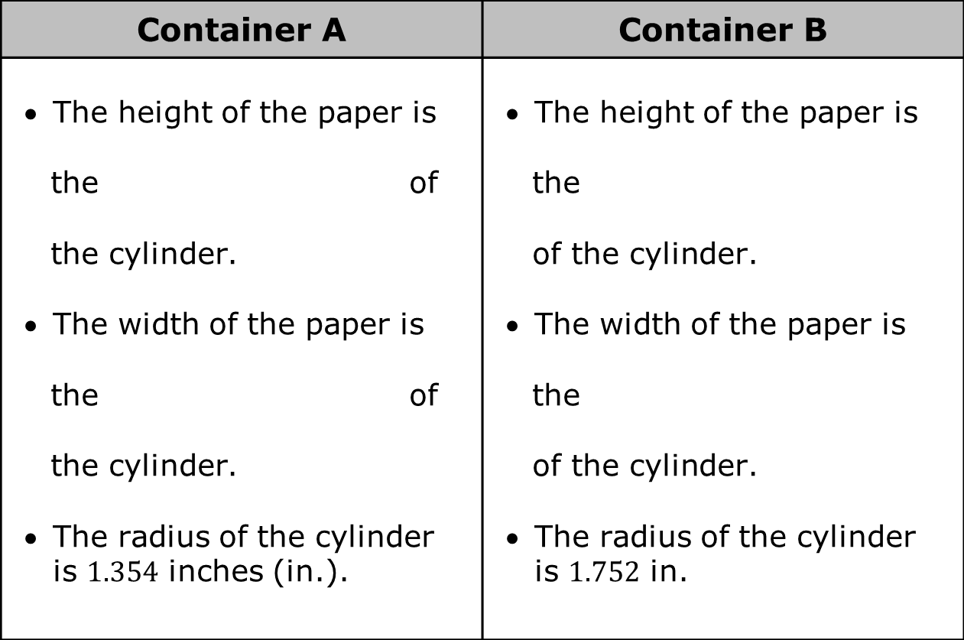
The radius of each resulting cylinder is given in the table. Complete the statements.
Container A | Container B
The height of the paper is the of the cylinder. The width of the paper is the of the cylinder. The radius of the cylinder is $1.354$ inches (in.). | The height of the paper is the of the cylinder. The width of the paper is the of the cylinder. The radius of the cylinder is $1.752$ in.
height
circumference
height
circumference
height
circumference
height
circumference
volume 2, pg. 225

Slide 13

Calculate the volume of each container. Use $3.14$ for $π$ and round to the nearest thousandth$.$
Complete the statement.
Container can hold more popcorn.
Volume of Container A | Volume of Container B
A
B
volume 2, pg. 226

Slide 14

Guided Instruction
volume 2, pg. 226

Slide 15
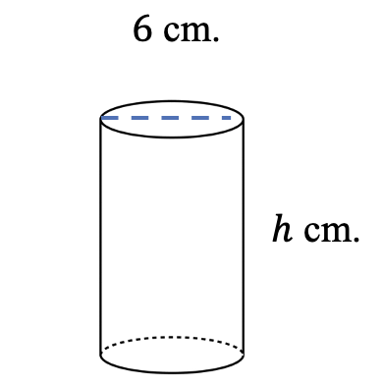
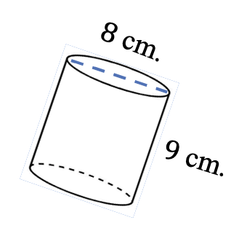
12.6.3 Guided Instruction: Using the Volume Formula to Problem-Solve
Cylinder C and Cylinder D have the same volume in cubic centimeters (cm³).
Cylinder C | Cylinder D
volume 2, pg. 226

Slide 16

Find the volume of Cylinder C. Leave it in terms of $π.$
Write an expression for the volume of Cylinder D.
$$V= __________________$$
Write an equation to show the volumes are equal to each other.
_______________ = _______________
volume 2, pg. 226

Slide 17
Solve the equation.
What does the solution to the equation represent?
volume 2, pg. 227

Slide 18

Try It
volume 2, pg. 227

Slide 19

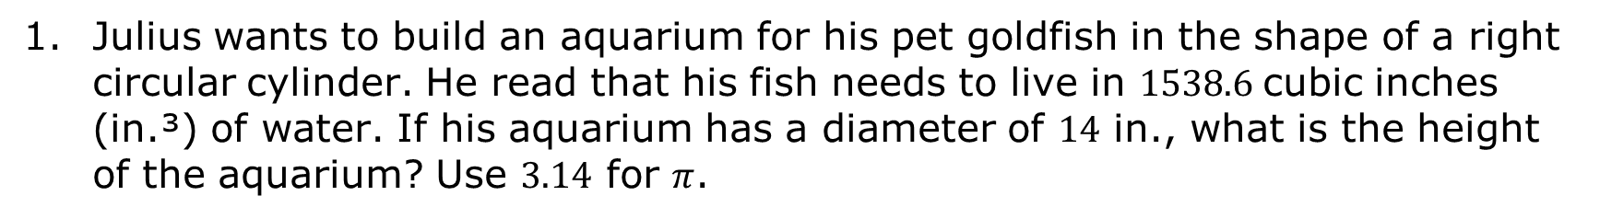
12.6.4 Try It: Finding the Height
Julius wants to build an aquarium for his pet goldfish in the shape of a right circular cylinder. He read that his fish needs to live in $1538.6$cubic inches (in.³) of water. If his aquarium has a diameter of $14$ in., what is the height of the aquarium? Use $3.14$ for $π$.
volume 2, pg. 227

Slide 20

Your Turn
volume 2, pg. 227

Slide 21
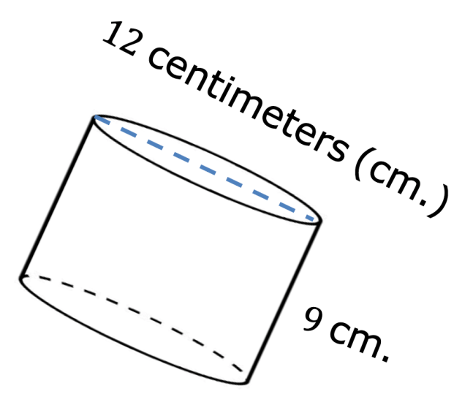
12.6.5 Your Turn!
Find the volume of the cylinder shown. Write your answer in terms of $π$.
volume 2, pg. 228

Slide 22
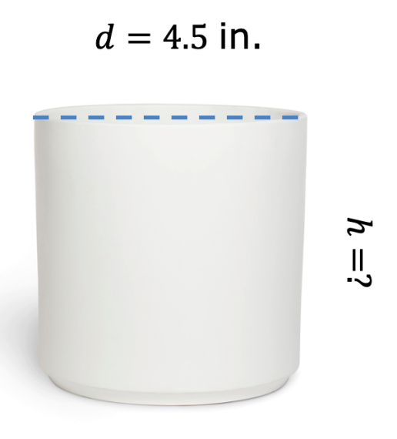
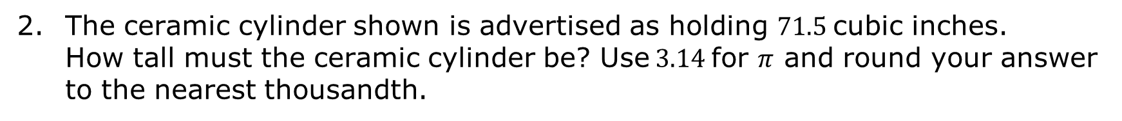
The ceramic cylinder shown is advertised as holding $71.5$cubic inches. How tall must the ceramic cylinder be? Use $3.14$ for $π$ and round your answer to the nearest thousandth.
volume 2, pg. 228

Slide 23
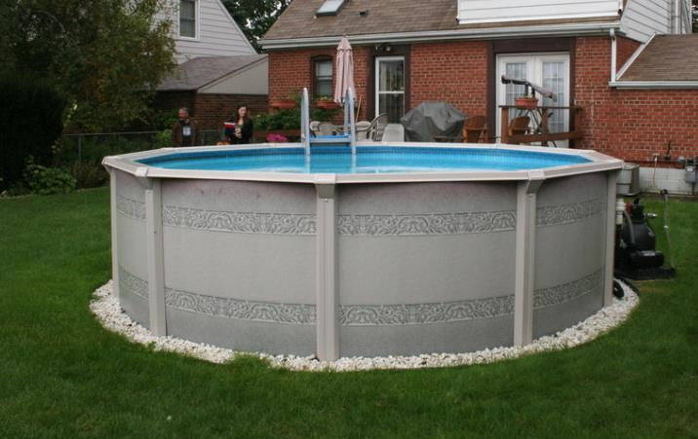
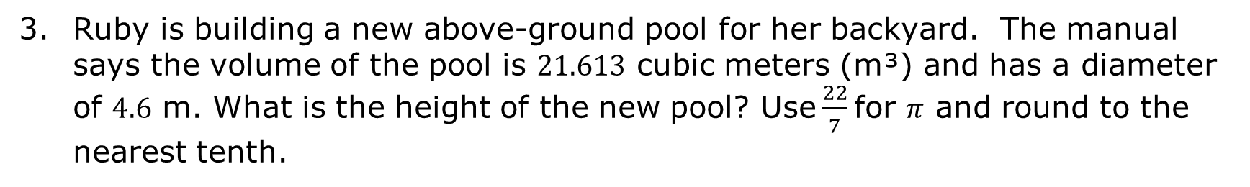
Ruby is building a new above-ground pool for her backyard. The manual says the volume of the pool is $21.613$ cubic meters (m³) and has a diameter of $4.6$ m. What is the height of the new pool? Use $\frac{22}{7}$ for $π$ and round to the nearest tenth.
volume 2, pg. 228

Slide 24

Wrap-Up
volume 2, pg. 229

Slide 25
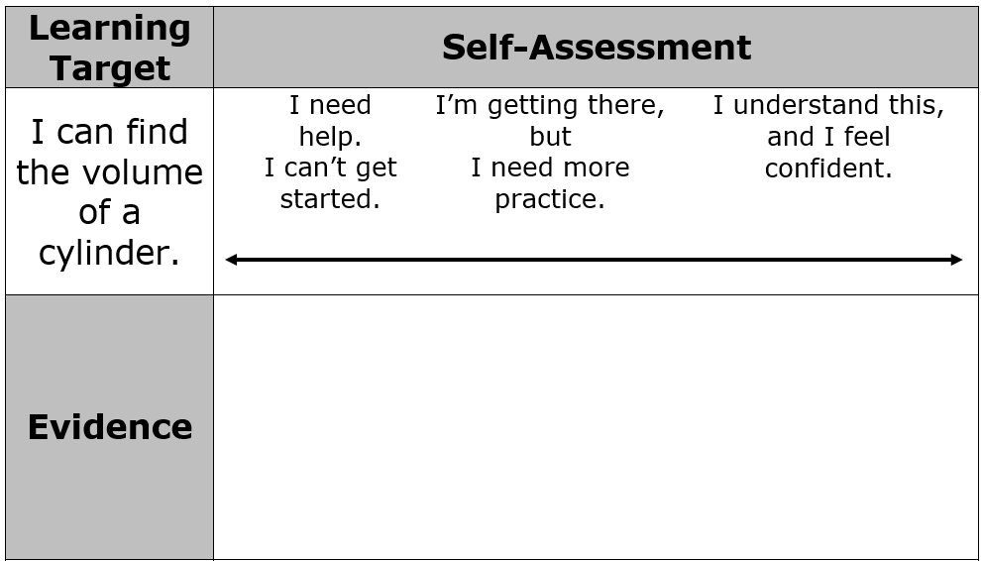
12.6.6 Wrap-Up: Reflection
Place an X on the line to indicate your understanding of each learning target. Then, provide a brief explanation or evidence to support your self-assessment.
volume 2, pg. 229

Slide 26
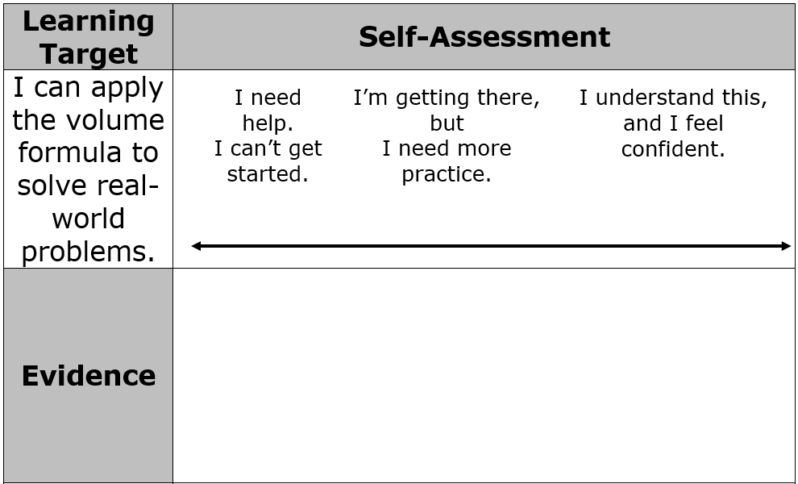
volume 2, pg. 229

